Slide 1
Capstone Project - The Battle of Neighbourhoods: Should I move from Lausanne to Bern? Christopher Tse, Dec 2019
I want to compare the livability of the two cities through using similar methods that have been used in the assignments from this course, and help me decide which area would be best for me - a young adult.

Slide 2
Introduction
I'm currently living in a city called Lausanne, on the French-speaking side of Switzerland, but there may be more job and life opportunities in a German-speaking city called Bern in Switzerland. I want to use data science to help me decide which city would suit me best to live.

Slide 3
Methodology - Data acquisition and cleaning
2.1 Data sources
In this project, I used Foursquare’s venue data to compare the most interesting regions of Lausanne and Bern.
2.2 Data cleaning
When retrieving the data from Foursqure, the data is collected in a JSON file, which needs to be converted into a pandas dataframe for further manipulation to only have the necessary data still present. Such unnecessary labels include “hasPerk”, “location.cc”, “location.country” etc.
What was kept was parameters which were useful such as id, lat and lng (identity, latitude, longitude respectively).
Such data types allowed me to create interactive maps to show the areas of interest.

Slide 4
Results and Discussion
Using Foursquare, I first start at the train station from each city. From the train station, I select all Migros supermarkets in the region. From each Migros supermarket, I list out all nearby venues within 1 km, compile into a list and use kcluster to match similar neighbourhoods together. These will be displayed onto an interactive map with folium and help me decide which areas I would like to live

Slide 5
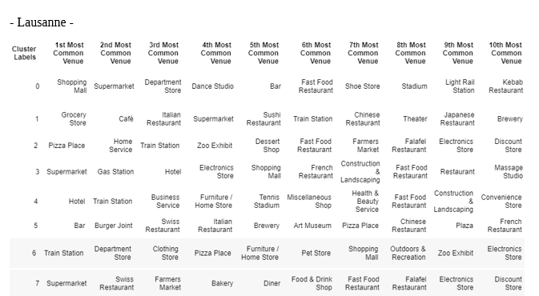
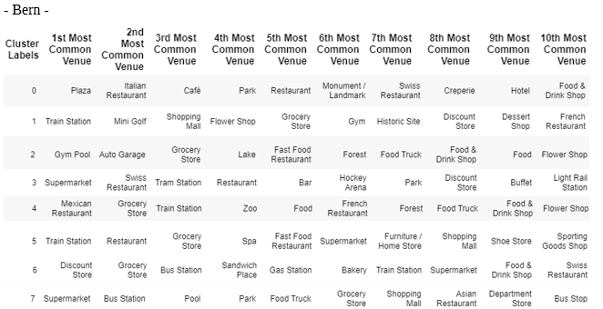
Most common venues in each cluster

Slide 6
Folium map to show each cluster

Slide 7
Best area to live for me

Slide 8
Conclusion
This script created for this project allows:
1. Contextual summary through combining Foursquare API and folium to assess attractiveness of each area.
2. Can be used for any city and any point of interest in the world making this translational for not just my needs, but for businesses and organisations to create contextual data of areas of interest.
3. Have up-to-date data as long as people still use the Foursquare API
4. Tailor the methodology easily i.e. radius, number of kclusters, vary the number of most common venues, change city and change areas to search can all be simply amended in the code.
However I did stumble upon some drawbacks which had caused inaccuracies and errors in the data;
1. Venues can have multiple unique venue ids, and human errors due to decentralised method of data collection by the general public. This is the strongest argument against using this technique.

